Slide 1
Eric M Haas, Health eData Inc
Argonaut 2020 Patient Lists

Slide 2

Who am I?
Eric M Haas, MS, DVM
Consultant Health eData Inc
Email: ehaas@healthedatainc.com
FHIR Zulip Chat

Slide 3

Argonaut Patient Lists
Scope
Background
Sketch of API
Implementation Experience
Demo
Roadmap
Next Steps
Resources

Slide 4

Argonaut Patient List Project Scope
GOAL: Support interoperable and standard exchange using the FHIR API for exposing existing EHR user-facing patient lists
“System Generated” Lists (e.g., Calender for the day showing patients)
“User Generated” Lists(e.g., Patients I want to follow up on)
Write is Out of Scope
Final Work Product will be an implementation Guide
Notes:
Writing, creating or managing a patient list is out of scope for this IG. Fetching client defined patients lists is also out of scope.

Slide 5

Background
User-facing apps often need to know things like:
“Who are the patients I’m seeing today,”
“Who are the patients I’m responsible for in the hospital right now,”
“Who are the patients in this ward.”
This core functionality is already supported by EHR systems
However no standards based guidance for creation of and manipulation of patient lists currently exists.
Several Options:
Search
Assemble Patients in List Resource
Assemble Patietns in Group Resource
Notes:
Note: When we say “EHR” in this document, we don’t mean to limit ourselves to electronic health record systems; the same technology can be used in HIEs, care coordination platforms, popoulation health systems, etc. Please read “EHR” here as a short-hand notation for something like “interoperable healthcare platform”.

Slide 6
Sketch of API
Patient List Uses the FHIR Group Resource
1. Discovery of ‘User Facing’ Lists
2. Fetch Patient List
3. Fetch Additional Data about each Patient

Slide 7
REMEMBER
For Patient List Think Group Resource
For our use case, Group lists members (`actual` = true) and members reference Patients using their logical FHIR ids.
Notes:
Sidebar Group vs List Resource:
There is some overlapping functionality between List and Group in FHIR. The methodological difference is that:
Group is an actor - a collection that can be a subject of an observation, a recipient of data, etc. It is primarily defined by criteria…
List on the other hand, is NOT an actor. It is an organizer for presentation purposes only. It is always enumerated and has no defined criteria.
Whether this difference merits 2 distinct resources remains an open question. The key practical advantages of Group is:
Support of the element and searchparameters for both the type - “person” in our case - and managingEntity for user and system maintained lists. In other words, it allow querying for a patient list based on multiple existing elements and search parameters without having to create extensions and custom search parameters in order to return a targeted list of lists.
Ability to display the members for presrentation when fetching an individual list.
Note that Group has no analogous search parameter to _list.
Comment

Slide 8
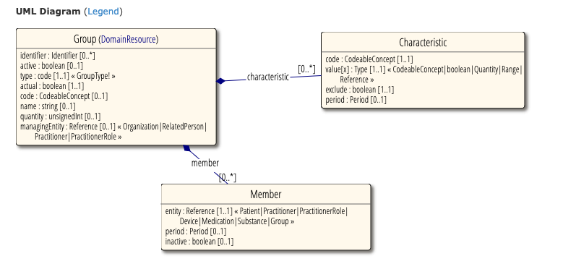
FHIR Group Resource

Slide 9
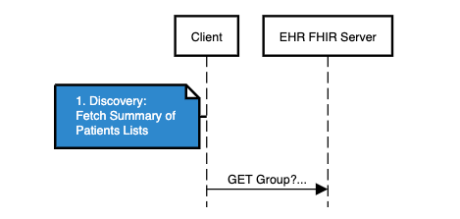
1. Discovery
Use Group Resource
Ability to Search by characteristic
Location
Practitioner
Organization
CareTeam
Ability to Search by manager of List
Use Summary Search to limit payload size

Slide 10
Example Search Syntax for Getting all the available Patient Lists
`GET Group?_summary=true&type=person&
characteristic=[Code value]&
value-reference=[Value value]
* value-reference is a custom SearchParameter in FHIR R4 added to FHIR R5

Slide 11
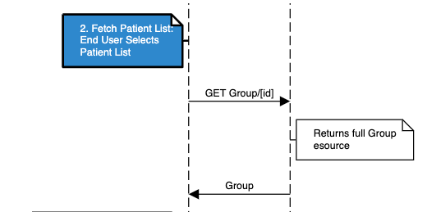
2. Fetch Individual Patient List
Patient list is selected using a simple Fetch operation:
/Group/[id]
End User gets the list of Members

Slide 12
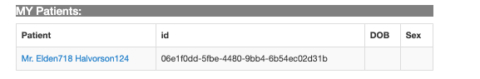
Are We Done?....
… Maybe, but typically need more data about the patient
etc.

Slide 13
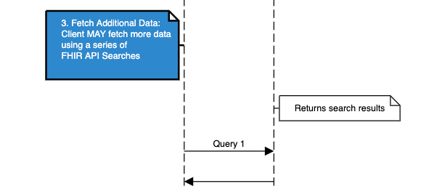
3. Fetch Additional Data about each Patient
The Simplest approach is to do a series of queries on the Server to fetch additional data…

Slide 14
Example Search Syntax for Getting data about the members in a Patient List
for each patient in Group:
GET Patient/ID
GET Observation/$lastn?patient=Patient/ID&category=laboratory
Notes:
Patient id is provided by the Group we just fetched

Slide 15
When a Patient Based Query Fails
Sometimes a patient based query isn’t going to get you what you want…
Returns requested data
???

Slide 16
Get the Specific Encounter or Appointment that defines the Group Membership
A patient-based search on Encounter or Appointment may not give you only the one you are interested in
Group
0..* Group.members
Group.member.extension to reference the specific Encounter or Appointment which define the group membership:
For example, the appointment for each patient I am seeing today.
Group
Notes:
A patient-based FHIR Query may not give you the data you want.
For example, a calculated score, a real-time measurement, an alert, even current graph or chart.

Slide 17
Fetching Additional Data Using Questionnaire
Group
Group.extension that references a Questionnaire form defining the data that is provided for each patient (Group.member)
0..* Group.members
Group.member.extension that references the filled out form (QuestionnaireResponse) supplying the patient data defined by the Questionnaire (filled by server not the patient)
Group
Notes:
A patient-based FHIR Query may not give you the data you want.
For example, a calculated score, a real-time measurement, an alert, even current graph or chart.

Slide 18
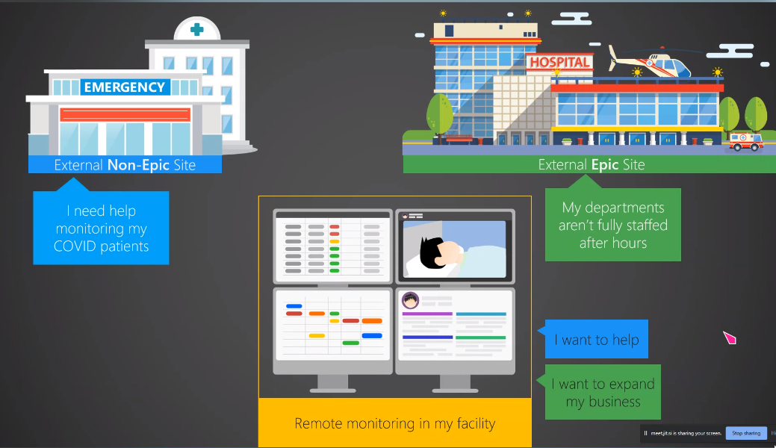
Using the Questionnaire Extension - Remote Monitoring
Thank you to Epic for sharing this content © 2020 Epic Systems Corporation
Notes:
Use cases for specialized care; off-hours care -- without requiring external clinicians on the viewing/supporting end to *store* data on their end.

Slide 19
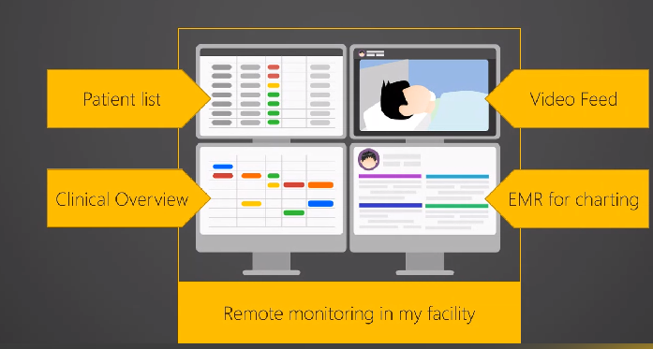
Using the Questionnaire Extension - Remote Monitoring
Thank you to Epic for sharing this content © 2020 Epic Systems Corporation
Notes:
At the core (upper left), patient lists with details about each individual. Source site can capture / calculate relevant metrics in a timely manner, and clinicians can open EHR to dig in or get further details. a “heads-up display”, sortable by columns like risk score

Slide 20
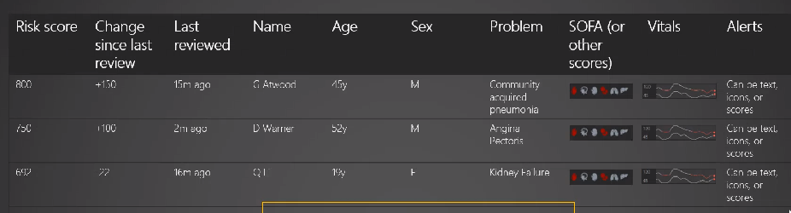
Using the Questionnaire Extension - Remote Monitoring
Thank you to Epic for sharing this content © 2020 Epic Systems Corporation
Notes:
a “heads-up display”, sortable by columns like risk score, Real time calculated data, not available as fhir resource. All defined by the Q resource and data suppied by the QR

Slide 21

Implementation Experience
HL7 Connectathon 25: Sept 10th,11th
Servers: Cerner, Meditech, Microsoft,
Clients: Apple, Epic, Microsoft, Argonaut Test App
Accomplishments:
Able to demonstrate basic proof of concept for above workflow for both Clients and Servers
Identified Several Issues

Slide 22
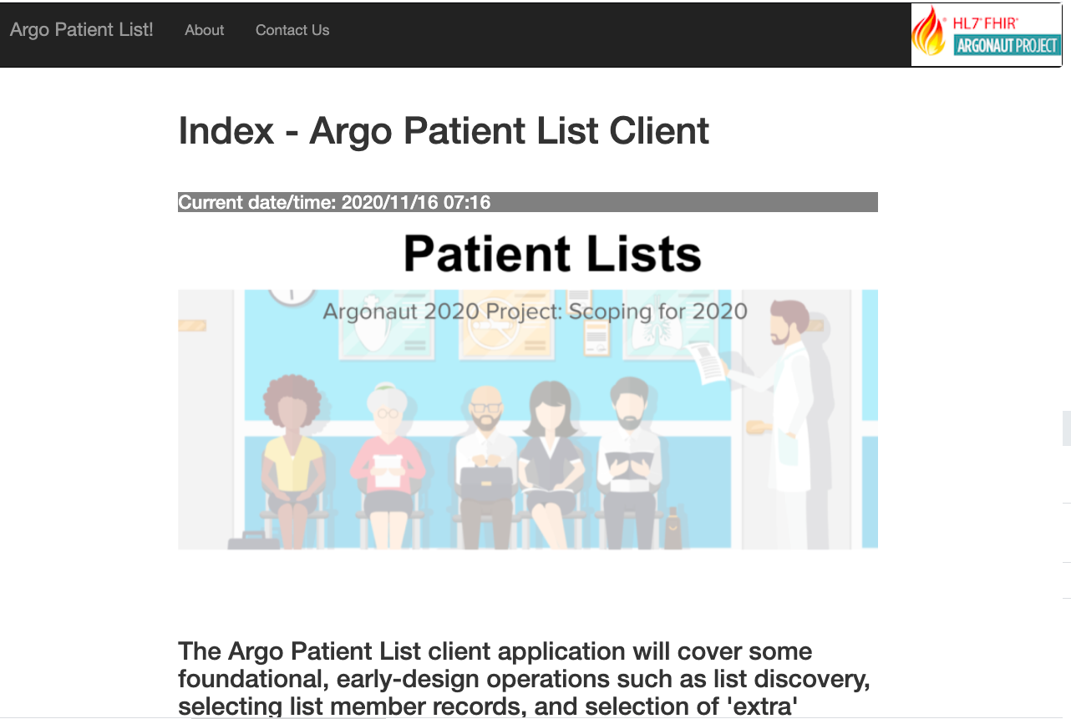
Live Demonstration

Slide 23

Argonaut Patient List Roadmap
April | Kickoff
May-June | Define Scope and API Design
July - August | Draft and Iterate on IG and prototype implementations
September | Connectathon Track - test multiple servers and clients
October - December | Iterate on IG and prototype implementations
January 2021 | ???: Ballot IG
 | Connectathon Track - test multiple servers and clients

Slide 24

Next Steps
HL7 FHIR January Connectathon
More Testing Capacity
Focus on getting additional Data using Q/QR
Large Lists
Getting Encounters and Appts that defined membership on the list
Publish Argonaut Implementation Guide
After more implementation experience hand off to HL7 for publishing as an HL7 IG.
Notes:
Jan 13, 2021 to Jan 15, 2021 - Virtual Event

Slide 25
Argonaut Patient List Resources
Patients lists Wednesday 1-2 PM EDT (Next Meeting ...)
Running meeting notes
Draft API (sequence diagrams, FHIR artifacts)
2020-09 Patient Lists Connecthon 25 Summary
Codelab exercise: https://aka.ms/patient-lists-codelab
Argo Patient Lists Test App

Slide 26
Q&A

Slide 27
Learning Objectives Tutorial/Let’s Build
Notes:
When writing learning objectives, we suggest that the initial word of each learning objective be a verb as shown on the http://ccc.clinton.edu/CurriculumCommittee/ListofMeasurableVerbs.cxml web page. Please ensure your learning objectives are located at multiple/different 'levels' (see https://teaching.uncc.edu/services-programs/teaching-guides/course-design/blooms-educational-objectives for additional details).

Slide 28
Presentation

Slide 29
What did you learn?
efer to the learning objectives

Slide 30
Contact
During DevDays, you can find / reach me here:
Via Whova App – Speaker’s Gallery
Email:
Twitter:

